Slide 1

EMPOWERING REAL-TIME
SALARIES

Slide 2
$72,850 OF OUTSTANDING BOUNTIES

Slide 3
COMMUNITY
FEBRUARY 15 2022
CALL #13

Slide 4
RICOCHET v2
NOW LIVE

Slide 5
RICOCHET
VERSION 2
COMING MARCH 31

Slide 6
RICOCHET
VERSION 2
COMING MARCH 31

Slide 7


POLYGON AMA
MARCH 4 2022 @ 17:30 CET
ON TWITTER SPACES

Slide 8
EFFORTLESS REAL-TIME INVESTING
A BETTER WAY TO INVEST RESPONSIBLY

Slide 9
$18,950
FEBRUARY 5 - FEBRUARY 11
BOUNTY PAYOUTS
(rexForce together STRONG 🦍)

Slide 10

EMPOWERING REAL-TIME
SALARIES
with Ricochet

Slide 11
rexMarkets
ANIMATED EXPLANATION

Slide 12

rexForce Community Representation

Slide 13

proposal
$25K BUYBACK
&
BANK
Notes:
The #rexForce has just surpassed $100k in bounty payouts 🥳
rexForce contributors are the vitality behind our products and community. We couldn’t be where we are today without them ♥
Want to join and start earning $RIC? We’ve got a robust bounty program ready for you. Learn more:

Slide 14
proposal
v2 Liquidity Mining Allocation
Notes:
The #rexForce has just surpassed $100k in bounty payouts 🥳
rexForce contributors are the vitality behind our products and community. We couldn’t be where we are today without them ♥
Want to join and start earning $RIC? We’ve got a robust bounty program ready for you. Learn more:

Slide 15

RICOCHET EXCHANGE
COMMUNITY CALL #9
SUNNY JAYCER
AGENDA
• Rex-products abstraction work
• LP incentives & Rex-Market
• Recap & outlook

Slide 16
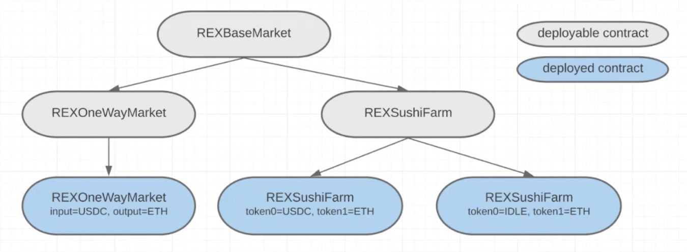
RICOCHET EXCHANGE
COMMUNITY CALL #9
SUNNY JAYCER
ARCHITECTURE
REXBaseMarket contains Superfluid integrations and IA share management
Level 2 shows the application specific extensions of the base
Level 3 contains deployed contracts, each initialized with different init params

Slide 17

RICOCHET EXCHANGE
COMMUNITY CALL #9
SUNNY JAYCER
IDLE DAO COLLABORATION
Incentives begin this Wednesday (12/23)
• USDC-IDLE rexMarket: $1,000 in $IDLE rewards over 30 days
• USDC-IDLE/WETH rexLP: $1,000 in $IDLE rewards over 30 days
Future
Stream invest into yield-bearing tokens
• DAI to idleDAO (+4.5% APR) example
• Support from Idle's Polygon Grant Program

Slide 18
THE NUMBERS
We’re growing. Fast.
TOTAL VALUE STREAMING (TVS)
ANNUALIZED VOLUME
RIC PRICE
$2.19M
$26.24M
$1.68
+175%
$525K REVENUE
$16.8M FDV | +79%
TREASURY BALANCE
USDCX ON LOAN
RIC IN TREASURY
$122K
$74K
$14.0M
+96%
$8.9K/YEAR IN REVENUE
8.3M RIC

Slide 19
SOME TABLE
TITLE

Slide 20

PRODUCT DISPLAY
One
What is this product
Two
What is this product

Slide 21




Font 1: Montserrat
Font 2: DM Sans
Font 3: DM Mono
RICOCHET RICOCHET
Navy: 1D2731
Light Blue: 6092C0
Light green: 81D048

Slide 22

Ricochet Community Call 12

Slide 24


